Slide 1
Can preprints accelerate pharma publishing? Educational material

Slide 2
A preprint is a version of a scientific manuscript posted to a public server before formal peer review and publication

Slide 3
Popular preprint servers for the health sciences
I need a preprint server that assigns a DOI to material and performs author checks
I need a platform to share my data and figures, in addition to my article
I want to post my article to a platform that exposes all or part of the peer review process

Slide 4
Benefits of sharing research as a preprint include …
Enable feedback before publication in a peer-reviewed journal As a form of discussion rather than a form of dissemination
Free of charge
No APC incurred to the author
Fast speed of research disclosure communication Posted rapidly on the desired preprint server
Available with open access Meaning anyone, anywhere in the world can access, review and comment on the research
Discoverable¹ Associated with a unique DOI allowing for version control

Slide 5
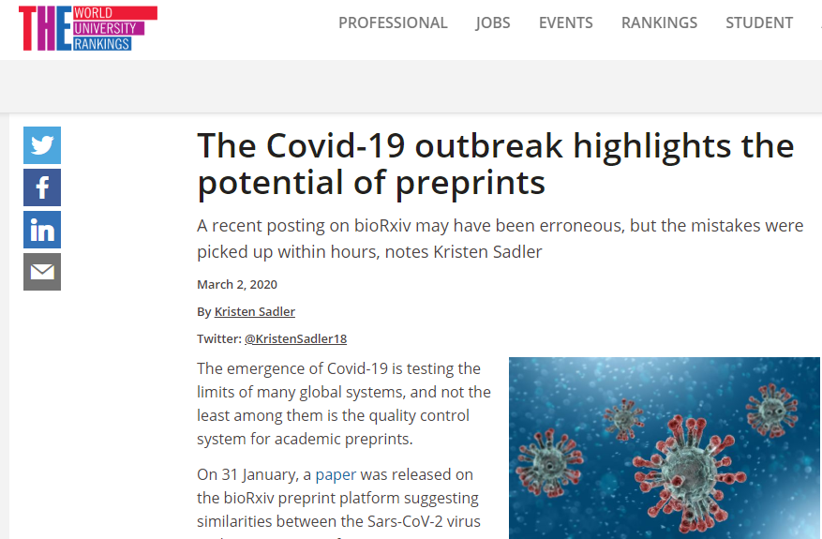
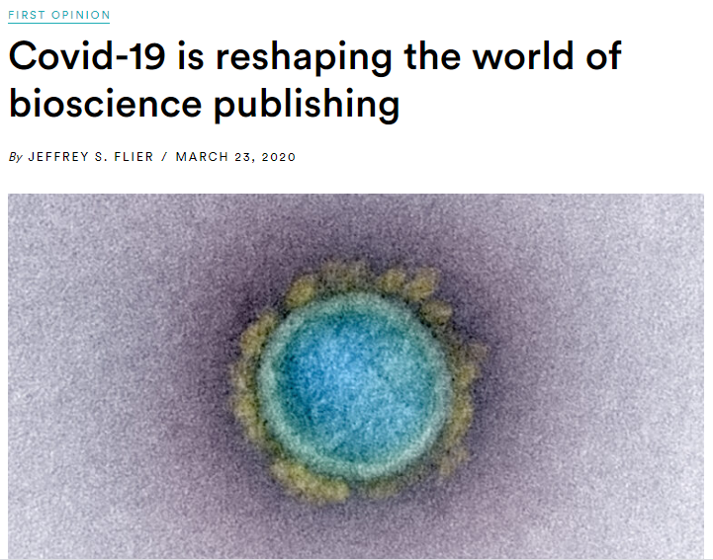
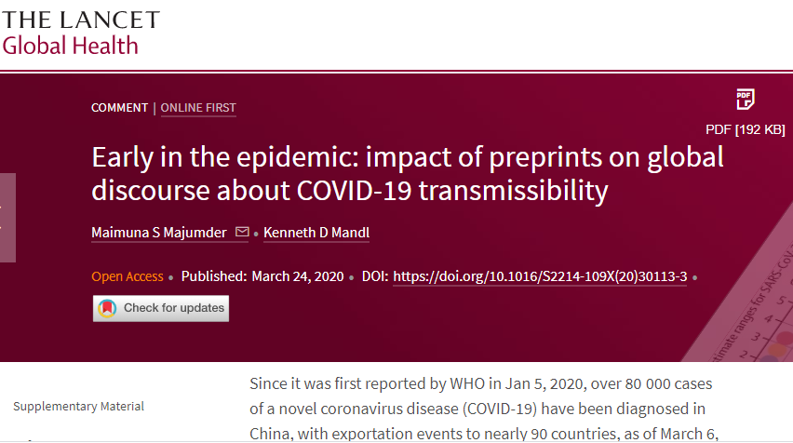
Preprints have the potential to accelerate research

Slide 6
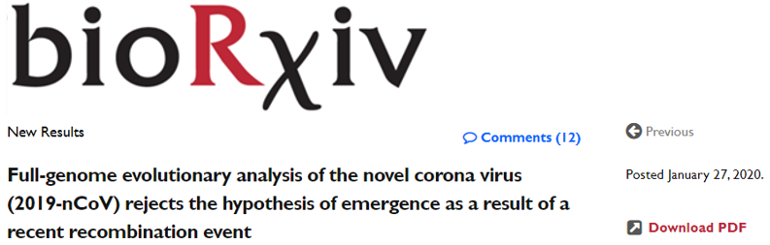
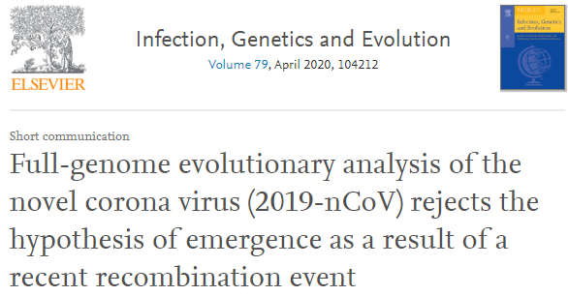
Research is made available months earlier than the peer-reviewed publication
2020
January | February | March | April
Published 68 days earlier on bioRxiv

Slide 7
Risks and mitigations for pharma preprints
Industry must be even more careful than publicly funded institutions
1. Some medical journals consider preprints a form of prior publication | Authors, not sponsors, choose target journals If a journal objected to a preprint, would the sponsor or the journal be held responsible for restricting author choice?
2. Preprints might sacrifice research quality for speed | Pharma publications have more quality control than non-industry research, resulting in better reporting quality Companies are not likely to risk substandard reporting quality Would allowing proper time for peer review improve the Version of Record compared with expedited publication processes?
3. Preprints may not count as the ‘safe harbour’ of ‘scientific exchange’ as do peer-reviewed publications by convention | Informal guidance from regulators, academics and patients is that the intent is key: is this bona fide scientific exchange? Posters are not peer reviewed (although abstracts are to a lesser degree than papers) and are increasingly accessible online; however, this is not perceived as promotion
4. Comments on preprints can make scientific disagreements public | Monitoring and moderation may be needed, in particular for adverse event reporting

Slide 8
Discoverable but not citable?
What, if any, citation of pharma preprints would be appropriate?
1. EFPIA, PCMPA, PhRMA and other regulations require peer-reviewed references for promotional claims | Preprints will not be used to support claims Pharma is well set with compliance processes to ensure that preprints are not used improperly
2. Preprints can be cited in grant applications to institutions such as the Wellcome Trust | Would preprints be citable in place of ‘data on file’ in pharma documentation such as health technology assessments and marketing authorization submissions, improving transparency?
3. Journalists, members of the public or other scientists may misuse or misinterpret the preprint and cite it as if it were a peer-reviewed source | Prominent labelling of non-pharma preprints has not prevented their occasional misuse in this way Would pharma be held accountable?
4. Preprints are public and discoverable by simple, direct Internet search | Public sharing of academic preprints is common, but pharma rarely even shares links to peer-reviewed papers to avoid any perceived promotion Is it realistic to expect preprints not to be cited by third parties? Is pharma responsible for third-party sharing and citation?

Slide 9
Most journals do not consider preprints as prior publicationsª
Of the five leading medical journals, three accept articles shared as preprints
 | Posting as a preprint will necessitate the decision as to whether publication will bring new/meaningful insight
 | No mention of preprints

Slide 10
Preprint servers employ checks to ensure research quality
Risk mitigation at bioRxiv
Is it nonsense?
Is it non-science?
Is it a paper?
Is it research?
Is it plagiarized?
Author undertakings
Automated check
CSHL check
Server affiliate check

Slide 11
Preprint servers employ checks to ensure research quality
medRxiv builds upon the checks performed at bioRxiv
Is it nonsense?
Is it non-science?
Is it a paper?
Is it research?
Is it plagiarized?
Is it a health threat?
Is there a benefit to sharing now?ª
Author undertakings
Automated check
CSHL check
Server affiliate check
Escalation 1 – experienced clinician editors
Escalation 2 – medRxiv leadership

Slide 12
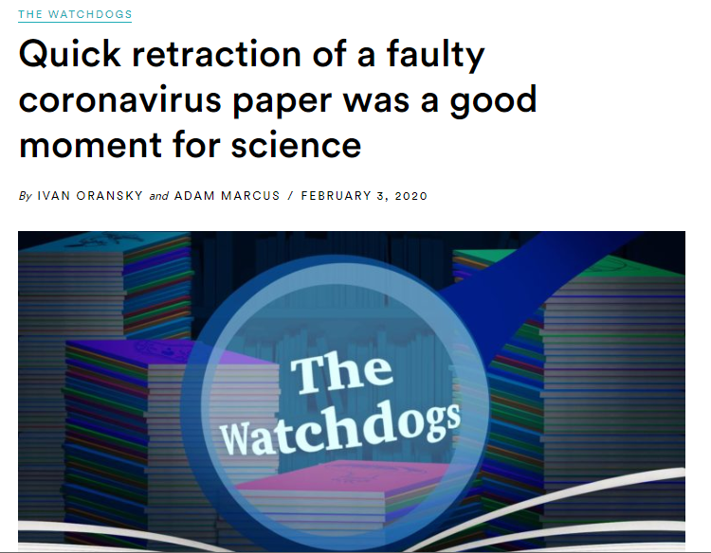
Preprint servers are equipped to deal with possible misinformation
A COVID-19 case study
The retraction occurred before the paper was covered by a single news outlet with any reach
bioRxiv placed a warning on all coronavirus papers
Preprint posted on bioRxiv
Formal retraction from bioRxiv
31 January 2020 | 1 February 2020

Slide 13
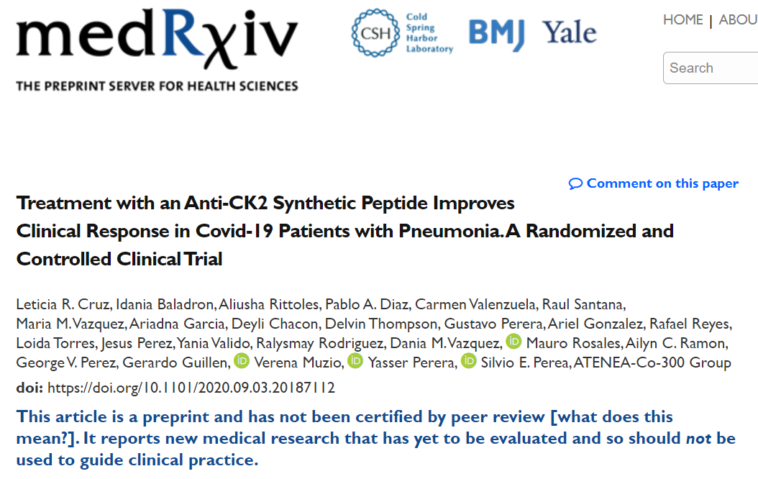
Preprints come with a bold disclaimer
Preprints provide an opportunity for scientific discussion
“Readers should therefore be aware that articles on medRxiv have not been finalized by authors, might contain errors, and report information that has not yet been accepted or endorsed in any way by the scientific or medical community”
“We also urge journalists and other individuals who report on medical research to the general public to consider this when discussing work that appears on medRxiv preprints and emphasize that it has yet to be evaluated by the medical community and the information presented may be erroneous”

Slide 14
Use of medRxiv by pharma was low in the 6-months after launch¹
Of the 335 preprints screened, only 26 (7%) stated funding from pharma
Of these 26 articles
13 (50%) had a pharma-affiliated author
6 (23%) described trials registered on ClinicalTrials.gov, including one phase 4 RCT

Slide 15
What research should be shared as a preprint?
Has COVID-19 changed this?
Real-world evidence
Preclinical research
Clinical research
PRO validation
Unapproved drug trial
Burden of illness study
In vitro/animal studies
Label-extension trial
Epidemiology
Assay/diagnostic validation
Off-label clinical trial
Research that can be preprinted
Research that cannot be preprinted
Could over 90% of research be made available as a preprint?

Slide 16
Useful links for preprints
Educational resources
https://www.annaclemens.com/blog/downsides-publishing-preprint
https://asapbio.org/preprint-info
https://publicationethics.org/resources/discussion-documents/preprints
https://www.slideshare.net/BaltimoreNISO/inglis-preprints-in-biology-and-medicine
Research
Anderson KR. bioRxiv [Preprint]. 2020. https://doi:10.1002/leap.1265 (Accessed 11 January 2021)
Carneiro C, Queiroz V et al. bioRxiv [Preprint]. 2020. https://doi.org/10.1101/581892 (Accessed 11 January 2021)
Fraser N, Momeni F et al. Quantitative Science Studies 2020;1:618–38
Karalian A, Jolly L and Booth M. Curr Med Res Opin 2020;36 Suppl 1:S11
Preprints and COVID-19
Fraser N, Brierley L et al. bioRxiv [Preprint]. 2020. https://doi.org/10.1101/2020.05.22.111294 (Accessed 11 January 2021)
Majumder, Maimuna S et al. Lancet Glob Health 2020; 8:627–30
https://www.nature.com/articles/d41586-020-01394-6
An industry viewpoint
AMWA-EMWA-ISMPP joint position statement on medical publications, preprints, and peer review. Current Medical Research and Opinion 2021;37(5):861–866 https://doi.org/10.1080/03007995.2021.1900365

