Slide 1
Building trust by connecting research information
Tim Koder at OASPA, 23 September 2021

Slide 2
A good time for trust in pharma publications?
Notes:
Trust in pharma, until recently very low, has been increasing worldwide during the COVID-19 pandemic, with some ups and downs
https://www.mmm-online.com/home/channel/pharma-surges-in-2021-edelman-trust-barometer/
https://www.mmm-online.com/home/channel/features/everybody-loves-pharma-unexpected-reputational-gains-since-covid-19-crisis/
Global R&D spend by pharma in 2020 USD$198bn, global market $1.25tn. https://www.statista.com/topics/6755/pharmaceutical-research-and-development-randd/
But still some people chose to buy horse dewormer, even though the pharma company who developed ivermectin, for which the licensed human use is for some specific parasitic worms and other conditions, has been very clear, alongside the FDA, that the drug should not be used for COVID-19. https://www.fda.gov/consumers/consumer-updates/why-you-should-not-use-ivermectin-treat-or-prevent-covid-19
Syringe and vial image from Flickr user NIAID (National Institute of Allergy and Infectious Diseasess, part of the NIH). CC BY licence. https://www.flickr.com/photos/niaid/14329622976/in/photolist-nQg4F7-nCkssY-52uTd-2kpd2Zp-2kiWxGD-2kT87mt-2gXMbLg-2kT9KPK-2kNxNcT-2iZBVUU-2gXQ7M3-2m3o2sN-2gXQDCr-2m3mURw-2gXQXyc-2gXQPAc-2gXMY7N-2gXRwqE-2gXQKpb-2gXMcbK-2kGQgj7-2kTf6Es-2kGLeF6-2jphB7m-2kiW1f9-8uKeGF-2gXQa4c-2gXQRYQ-2kTaz2p-2gXQLH3-2gXQY2X-2gXQPc6-2gXQ6AW-2gXMcT1-2gXMYMa-2gXMcvC-2gXMcnB-2gXRuN1-2gXMXAH-2gXMbBi-2kiW1bX-2kRsPbb-2gXRrvQ-2h4e8Up-2gXQSFG-LeKmKd-2kuptBk-2jpeNkG-2kp8vKX-75Qow8
Horse on Humpty Hill by Tim Koder, I’ll give it a CC BY

Slide 3
Who’s this?
Tim is… director of a group of writers, editors, account and project managers, following 14 years in med comms, 3 years in medical publishing and too long in neuroscience labs
Oxford PharmaGenesis is… an award-winning HealthScience communications consultancy providing services to the healthcare industry, professional societies and patient groups
Open Pharma is… a collaborative, multi-sponsor, non-profit project at Oxford PharmaGenesis
Members:
AstraZeneca
Boehringer Ingelheim
Galápagos
Gilead Sciences
GSK
Novo Nordisk
Pfizer
Takeda
Supporters:
Alexion
Bristol Myers Squibb
Ipsen
Novartis
Roche
UCB
Wiley
3

Slide 4
Academic publishing is the route to credible, compliant pharma communications
Established, independent, organic system for transferring research information into research practice
Personal professional accountability for medical professionals who lead and report from clinical trials
Third party quality assurance and quality control from editorial and peer review, and production editorial
‘Safe harbor’ for ‘scientific exchange’
Notes:
Photo of Bristol harbour by Tim Koder, I’ll give it a CC BY

Slide 5
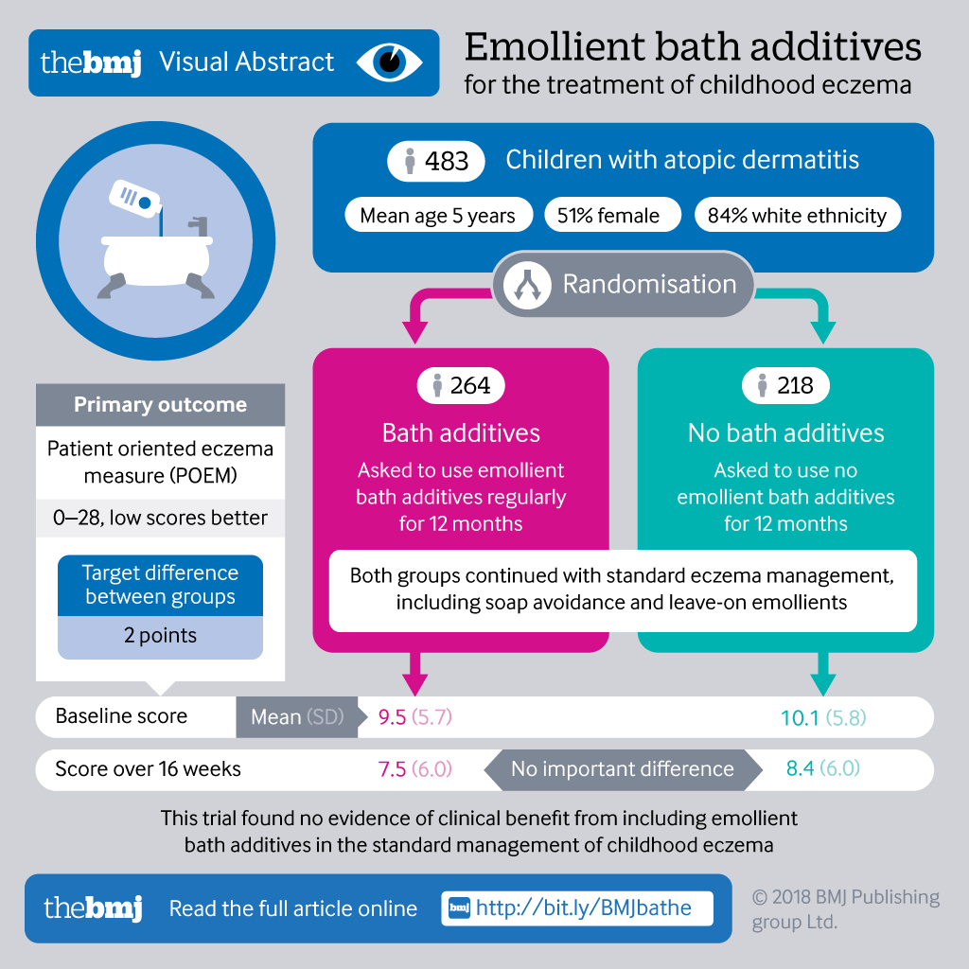
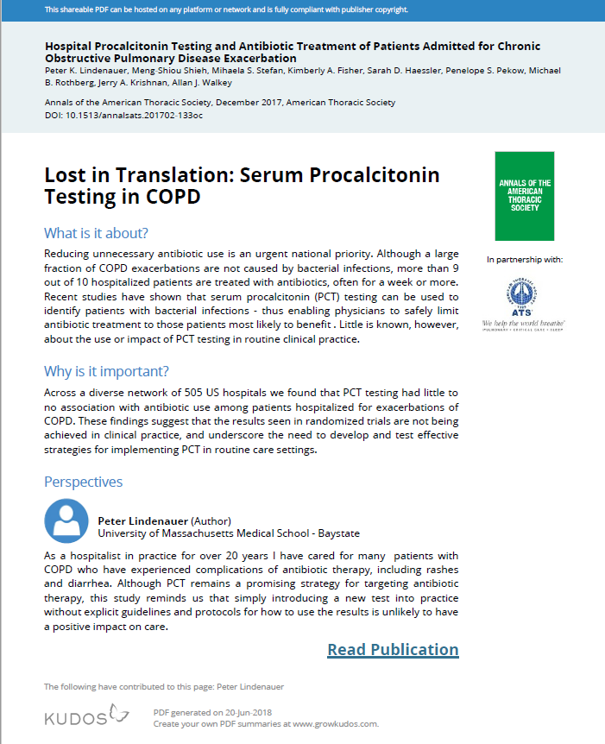
Non-publication media help to summarize, simplify and explain
Explanatory videos
Infographics
Plain Language Summaries

Slide 6
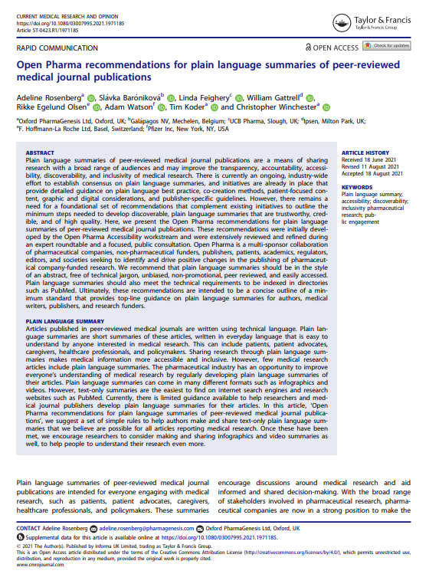
Recommendations for plain language summaries of peer-reviewed medical journal publications
Developed by the Open Pharma Accessibility workstream, with content driven by an expert roundtable and focused public consultation
Proposes a foundational standard for plain language summaries for sharing research broadly and understandably
Notes:
Read the ‘Meet the authors’ guest blog post on Open Pharma at: https://www.openpharma.blog/blog/plain-language-summaries/meet-the-authors-of-the-open-pharma-recommendations-for-plain-language-summaries/
The open science movement has won the argument that everyone should be able to see the results of research, and medical research in particular. Now, I believe if we’re publishing peer-reviewed articles open access for the world to read, providing a summary that people can understand is just the responsible thing to do.”

Slide 7
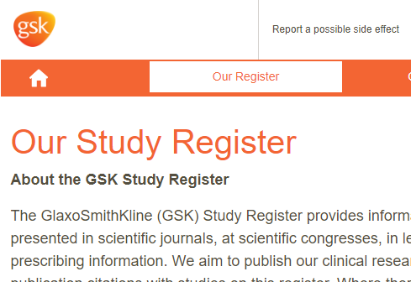
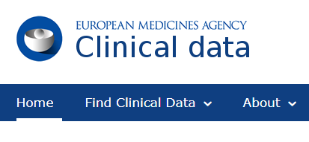
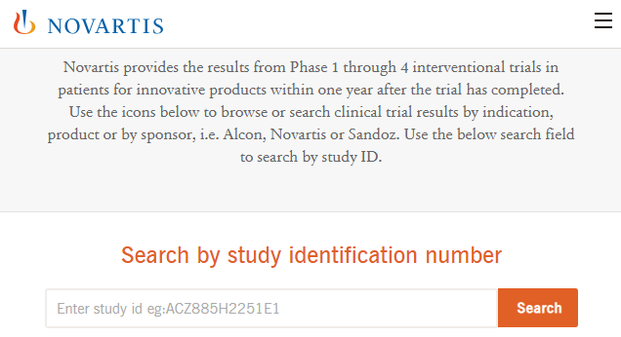
Publications are not the only way to clinical data

Slide 8
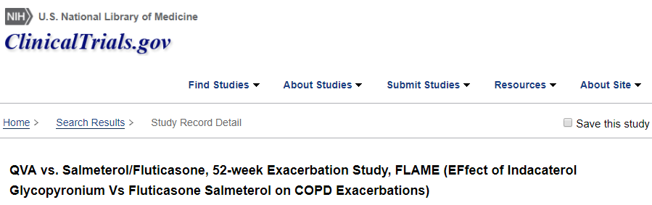
Connecting to external resources can provide a fuller picture
Select what’s important. Resolved by providing the complete picture through links

Slide 9
… and provide further context

Slide 10
The library without a system
The internet is used by billions of people and is the largest repository of information in human history
But where is the info I need now?
Data
repository
?
News outlet
Congress
Journal 2
FDA/EMA
CSR repository
ClinicalTrials.gov
Preprint
server
Journal 1
Funder clinical
trial registry
Lay summary
platform
Ethical
approval
Funder
repository

Slide 11
Systems helping with discoverability
11

Slide 12
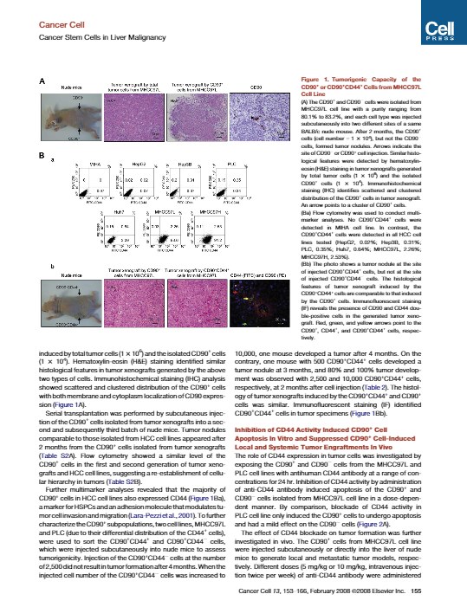
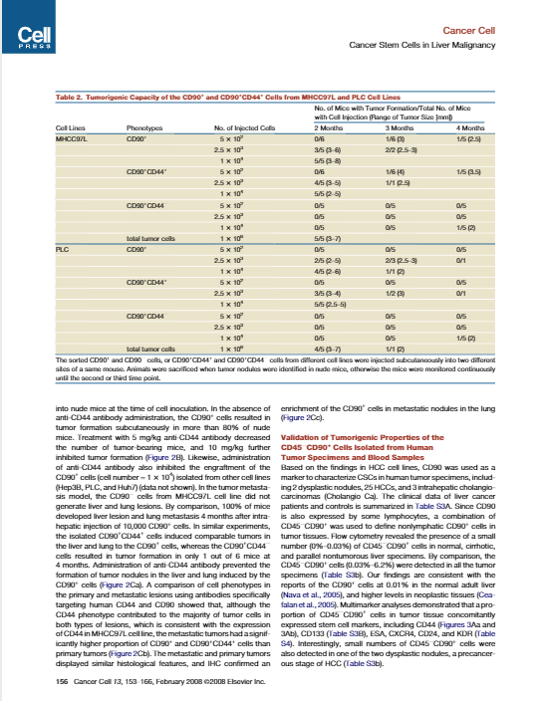
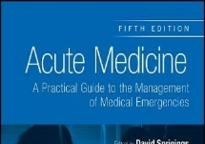
So you want people to read this?
Total score
Reach (short term)
Engagement (medium term)
Impact (long term)
The right audiences are aware of publications
Audiences want to know more. They access and save publications, as well as associated content
Audiences act as advocates for the evidence. Information is used to shape clinical practice, guidelines, and policies
¹Tool to measure real-world publication reach, engagement and impact. Rees T, Lang H and Gattrell W. Presented at Virtual ISMPP EU, 26–27 Jan 2021.

Slide 13
Metrics over time
Reach (immediate/short term)
Engagement (medium term)
Impact (long term)
Tweets start to appear
News outlets
pick up
research
Social
network sharing
Reference library saves, blog posts written
Wikipedia
articles updated
Citations in research highlights
Citations in journal articles, guidelines, and policy documents
Tweets start to appear
News outlets
pick up
research
Social
network sharing
Reference library saves, blog posts written
Wikipedia
articles updated
Citations in research highlights
Citations in journal articles, guidelines and policy documents
Number of mentions
Hours
Days
Months
Time since publication
Figure adapted from Porter S. A new ‘research data mechanics’. Digital Science, 2016. ¹Tool to measure real-world publication reach, engagement and impact. Rees T, Lang H and Gattrell W. Presented at Virtual ISMPP EU, 26–27 Jan 2021.

Slide 14
But how does this make my life better?!
And what can I show to senior management?
Your client
See pattern
Drill down to understand pattern
Tell them something valuable
But who do we want to read what? What measures are appropriate?
Is it ok to ‘promote’ medical science or deliberately choose authors, publishers or platforms with that in mind?

Slide 15
So what does this mean for publishers?
Opportunities
Challenges
You are the route for credible information
Health information matters, for everyone
Innovations are making it easier to find info
Pharma R&D spend is $200bn a year
There is enough money in the system
A sustainable, diverse ecosystem is a must
How do we most credibly link accessible science with the scrutinized evidence?
Discoverability, accessibility… marketing? Is it right for some science to be promoted?
Restrictive licences slow progress and lessen your value to funders – open up!
How can we ensure equitable openness?

Slide 16
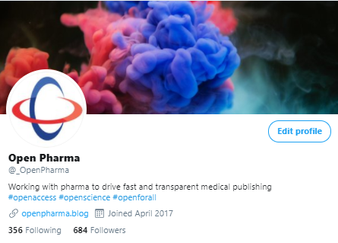
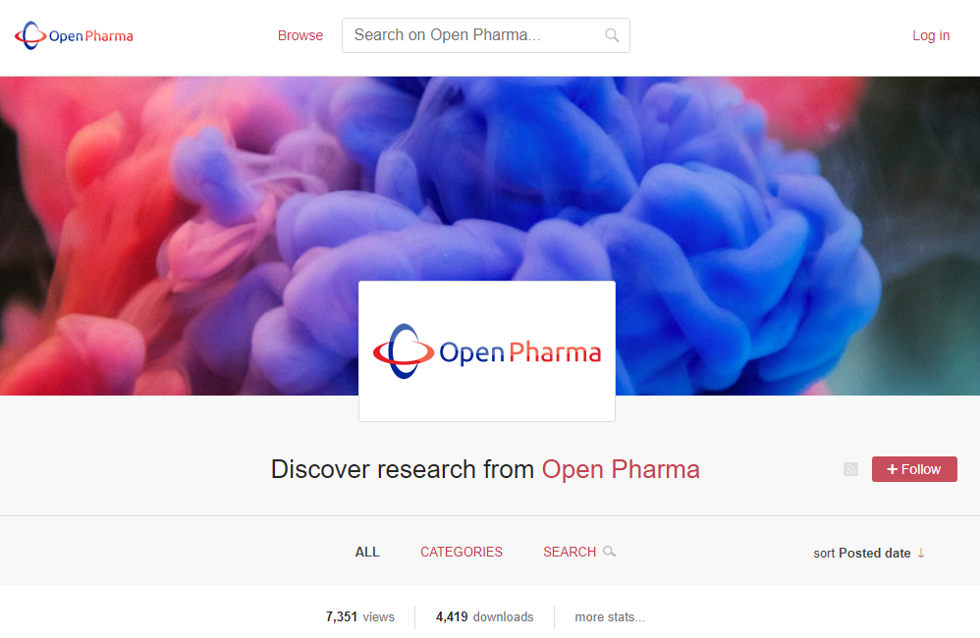
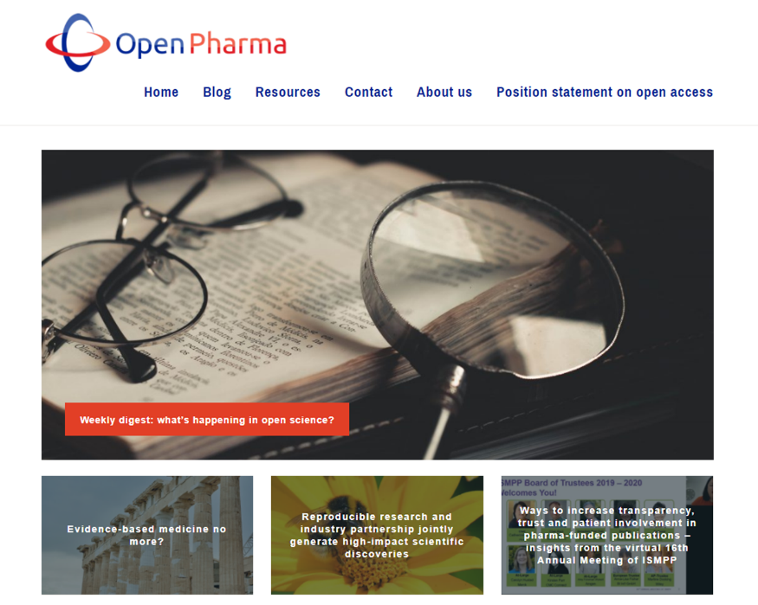
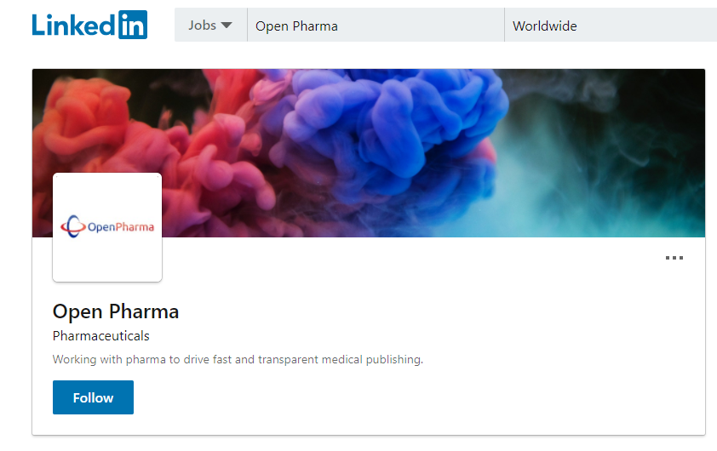
Join the conversation
804 followers on Twitter
223 followers on LinkedIn
382 subscribers to the blog
206 weekly digests
47 guest blog posts
63 original articles
@_OpenPharma
https://openpharma.blog
https://www.linkedin.com/showcase/open-pharma
https://openpharma.figshare.com

